Slide 1
S4 Training Modules
GeoDa: Spatial Regression
Spatial Regression with GeoDa
This lab includes discussion of two types of models of spatial dependence
Spatial lag
Spatial error
It then shows how to estimate simple spatial regression models in GeoDa
Classical OLS regression with diagnostics
Spatial lag model vs. Spatial error model
Data and Shapefiles:
We will use a US 2000 Census data for Manhattan in New York City. The zipped data file is on the S4 Training page and can be downloaded from http://www.s4.brown.edu/S4/about.htm click on S4 tutorials; scroll down to GeoDa 3.
The shapefile newyork.shp is the map of Manhattan in New York City with Census 2000 data from summary file 3. These are socioeconomic attributes for 297 Census tracts. It includes the following variables:
Vraiable name Label
POLYID STATE COUNTY TRACT
sctrct00 hvalue t0_pop pctnhw pctnhb pcthsp pctasn t0p_own t0p_coll t0p_prf t0p_uemp t0p_for t0p_rec t0_minc t0p_poor
Polygon ID State FIPS County FIPS Census Tract ID FIPSID
Median housing value Total population
Percent non-Hispanic white persons Percent non-Hispanic black persons Percent Hispanic persons
Percent Asian persons Percent homeowners Percent college educated
Percent of people employed in professional/managerial occupations Percent of people unemployed
Percent foreign born persons Percent recent immigrants Median household income
Percent total population below poverty

Slide 2
S4 Training Modules
GeoDa: Spatial Regression
1. Standard linear regression - Ordinary Least Squares (OLS)
The general purpose of linear regression analysis is to find a (linear) relationship between a dependent variable and a set of explanatory variables:
y = X β + ε
The method of ordinary least squares (OLS) estimation is referred to as a Best Linear Unbiased Estimator (BLUE). The OLS estimates β by minimizing the sum of squared prediction errors, hence, least squares. In order to obtain the BLUE property and make
statistical inferences about the population regression coefficients from the estimated b,
certain assumptions about the random error of the regression equation need to be made. These include:
the random errors have a mean of zero (there is no systematic misspecification or bias in the population regression equation);
the random errors have a constant variance (homoskedasticity) and are uncorrelated;
the random errors have a normal distribution.
2. Spatial dependence
These assumptions may not be always satisfied in practice. When a value observed in one location depends on the values observed at neighboring locations, there is a spatial dependence. And spatial data may show spatial dependence in the variables and error terms.
Why should spatial dependence occur? There are two reasons commonly given. First, data collection of observations associated with spatial units may reflect measurement error. This happens when the boundaries for which information is collected do not accurately reflect the nature of the underlying process generating the sample data.
A second reason for spatial dependence is that the spatial dimension of a social or economic characteristic may be an important aspect of the phenomenon. For example, based on the premise that location and distance are important forces at work, regional science theory relies on notions of spatial interaction and diffusion effects, hierarchies of place and spatial spillovers.
There are two primary types of spatial dependence:

Slide 3
S4 Training Modules
GeoDa: Spatial Regression
a. Spatial error -the error terms across different spatial units are correlated
X_{i}
X _{j}
y _{i}
y _{j}
ε_{i}
ε _{j}
With spatial error in OLS regression, the assumption of uncorrelated error terms is violated. As a result, the estimates are inefficient. Spatial error is indicative of omitted (spatially correlated) covariates that if left unattended would affect inference.

Slide 4
S4 Training Modules
GeoDa: Spatial Regression
b. Spatial lag- the dependent variable y in place i is affected by the independent variables in both place i and j.
X_{i}
X _{j}
y _{i}
y _{j}
ε_{i}
ε _{j}
With spatial lag in OLS regression, the assumption of uncorrelated error terms is
violated; in addition, the assumption of independent observations is also violated. As a result, the estimates are biased and inefficient. Spatial lag is suggestive of a possible diffusion process – events in one place predict an increased likelihood of similar events in neighboring places.
GeoDa provides a range of diagnostics to detect spatial dependence. It also provides unbiased regression estimates using a Maximum Likelihood approach (ML Spatial Lag or Spatial Error models).
Spatial regression in GeoDa
Start a project and create weights matrix
Start GeoDa by Click the Start > Programs > Instructional Tools > GeoDa,
Go to File > Open Project .
Browse through the folder to find and select the shape file, newyork.shp.
Select POLYID as the “Key Variable” (by scrolling and clicking on variable name). The Key Variable must have a unique value for each observation (i.e., in this case Census tract). The unique value is used to implement the link between maps and statistical graphs.
Click OK. Your screen should now look something like …
Start GeoDa
File – New Project From – ESRI Shapefile (*.shp)
Go into the NewYork folder and select NewYork.shp
You should see a window appear with New York and 297 census tracts:

Slide 5
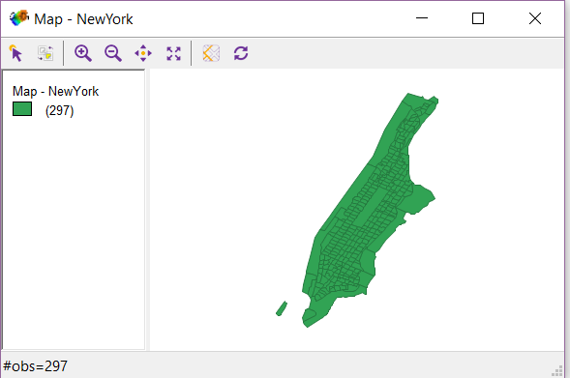
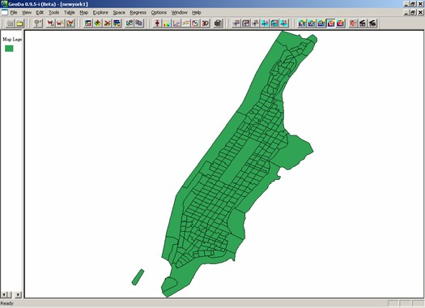
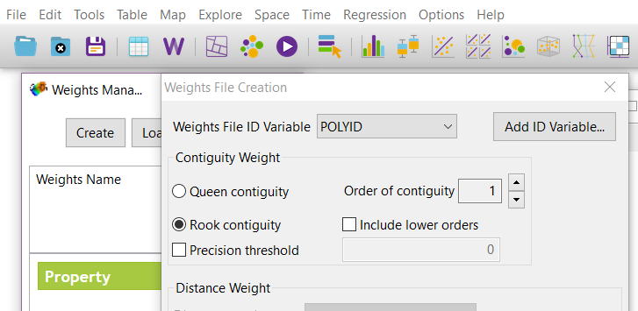
S4 Training Modules
GeoDa: Spatial Regression
To create a Weights File:
Click on W
Click on Create.
Select POLYID as the Wts File ID.
Select Rook contiguity.
f. Create a weights matrix. Go to
Tools > Weights > Create to open the
Creating Weights dialogue box.
In the Creating weights dialogue box:
Select newyork.shp as the input, type “rook” in the Save output as (the default extension is .gal), Select POLYID as the ID variable for the weights file.
Select Rook Contiguity, click Create, then Done.
3.1. Classical OLS regression with diagnostics.
Now, we are ready to perform an OLS regression and evaluate the spatial dependence in this regression.
a. On the menu bar, choose Regress. A dialogue box will appear:
Then, click on Create
Save the Wts file
Click on Close
Click on Histogram – Explore
Click on Connectivity Map – Explore
Exit out of the Weights Manager
We are now ready to perform an OLS regression and
Evaluate the spatial dependence.
Click on Regression – Regression

Slide 6
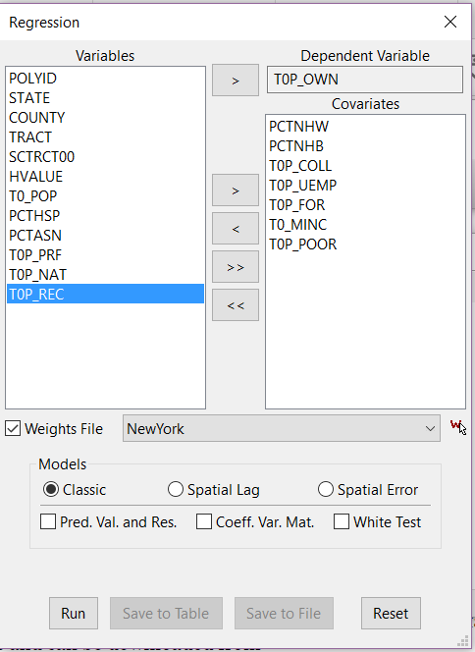
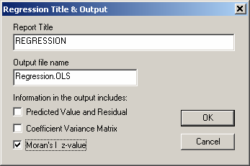
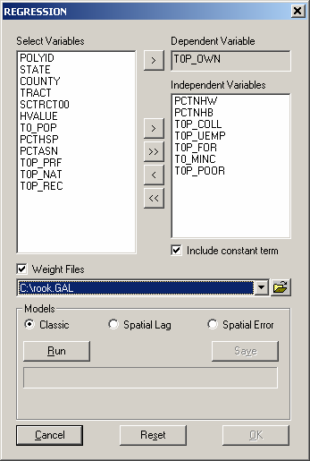
S4 Training Modules
GeoDa: Spatial Regression
In this example, we will predict neighborhood homeownership with several indicators, including % non-Hispanic white, % non-Hispanic black, % college+ educated,

Slide 7
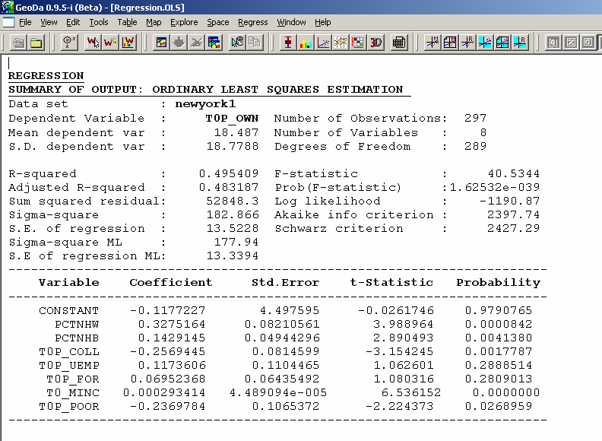
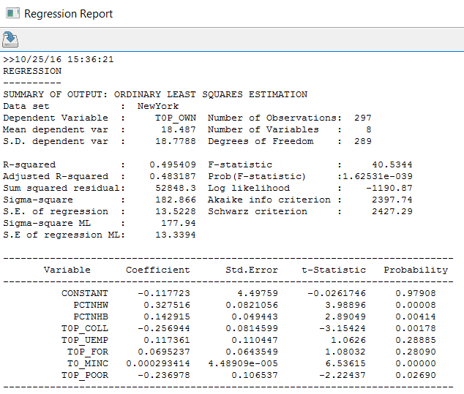
S4 Training Modules
GeoDa: Spatial Regression
unemployment rate, % foreign born, median household income, and % person below poverty.
Browse to locate the weights matrix file you just created and check the Weight Files
box.
Check Classic- this will run classical OLS regression with spatial dependence diagnostics, click Run. When done, click OK.
A new window of regression output will appear, and it has several sections.
1) The first section is the summary output of OLS regression:
Run
It first shows general information of the run, including the mean and standard deviation of the dependent variable, the model coefficient of determination, F-test probability,
and Log likelihood. Then, the coefficients, standard errors, and significance are shown. We can see that among the seven indicators, % non-Hispanic white, % non-Hispanic black, % college+ educated, and median household income are positively related to homeownership; while poverty rate is negatively related to homeownership; and
unemployment rate and % foreign born have insignificant effects.
2) The next section deals with regression diagnostics:

Slide 8
S4 Training Modules
GeoDa: Spatial Regression
GeoDa tests multicollinearity of the model- one should be alarmed when
MULTICOLLINEARITY CONDITION NUMBER is greater than 20. The Jarque-Bera test
is used to examine the normality of the distribution of the errors. This test is a test of the combined effects of both skewness and Kurtosis. The low probability of the test score indicates non-normal distribution of the error term. Since the following tests of variance and spatial dependence are conditioned upon normal distribution, in real research, one should be very cautious to interpret the test results. Here, we simply give the illustration of how to interpret the diagnostics when non-normality is not encountered.
3) DIAGNOSTICS FOR HETEROSKEDASTICITY- a test of the variance of the error term as the BLUE requires constant error variance.
The low probabilities of the three tests point to existence of heteroskedasticity. This is not necessarily a surprise because the error variance could well be affected by the spatial dependence in the data.
4) DIAGNOSTICS FOR SPATIAL DEPENDENCE
There are six tests performed to assess the spatial dependence of the model. First,
Moran’s I score of 0.196 is highly significant, indicating strong spatial autocorrelation of the residuals. In addition, the function reports the estimates of tests chosen among five statistics for testing for spatial dependence in linear models. The statistics are the simple LM test for a missing spatially lagged dependent variable (Lagrange Multiplier

Slide 9
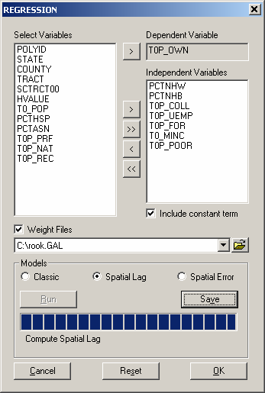
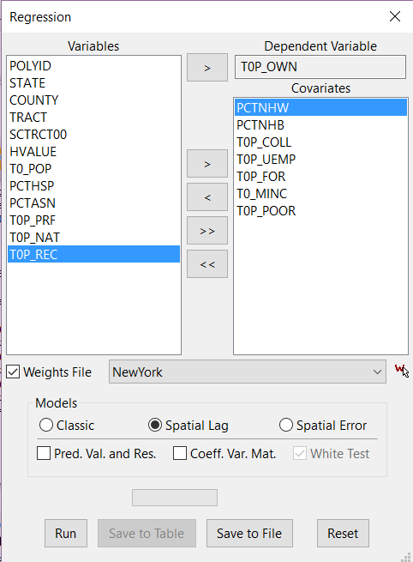
S4 Training Modules
GeoDa: Spatial Regression
(lag)), the simple LM test for error dependence (Lagrange Multiplier (error)), variants of these robust to the presence of the other (Robust LM (lag) and Robust LM (error)-
which tests for error dependence in the possible presence of a missing lagged dependent variable, Robust LM (lag) is the other way round), and a portmanteau test (SARMA, in fact Lagrange Multiplier (error) + Robust LM (lag)).
We can see both simple tests of the lag and error are significant, indicating presence of spatial dependence. The robust tests help us understand what type of spatial dependence may be at work. The robust measure for error is still significant, but the robust lag test becomes insignificant, which means that the error model is the preferred choice.
3.2. Spatial lag model vs. spatial error model
After identifying the presence of spatial dependence, we will use GeoDa to re-estimate the model with maximum likelihood approach while controlling for the spatial dependence.
On the menu bar, choose Regress. Check Moran’s I z-value in the output box, and click OK.
In the variable selection box, set dependent and independent variables as before. Check Weight Files, and browse to locate the weights matrix file.
Check Spatial Lag in the Models selection, and click Run.

Slide 10
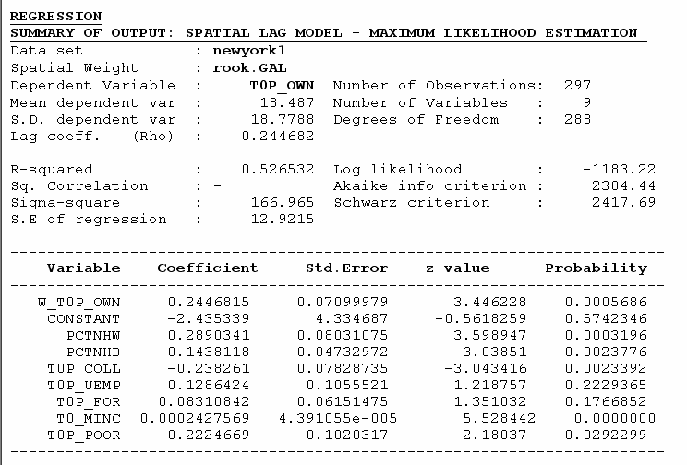
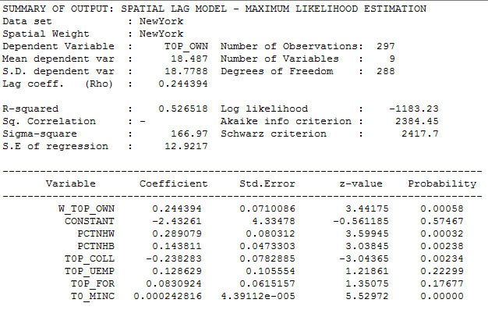
S4 Training Modules
GeoDa: Spatial Regression
Check Spatial Error and click Run. Then click OK.
Two new windows of regression output will appear, and they present results for both spatial lag and spatial error models.
1) First, we see the results from spatial lag model. Again, it consists of multiple sections and begins with general information and regression coefficients with significance tests.
Notice, besides the information that appeared in previous OLS regression output, we have a designated spatial weight file: rook.GAL. And the spatial lag term of homeownership W_T0P_OWN appeared as an additional indicator. (Its coefficient parameter (Rho) reflects the spatial dependence inherent in our sample data, measuring the average influence on observations by their neighboring observations.) It has a positive effect and it is highly significant. As a result, the general model fit improved, as indicated in higher values of R-squared and Log likelihood. The effects of other independent variables remain virtually the same.
2) The following sections show tests of Heteroskedasticity and Spatial dependence.
NewYork
More importantly, the AIC decreased.
10
Spatial Structures in the Social Sciences

Slide 11
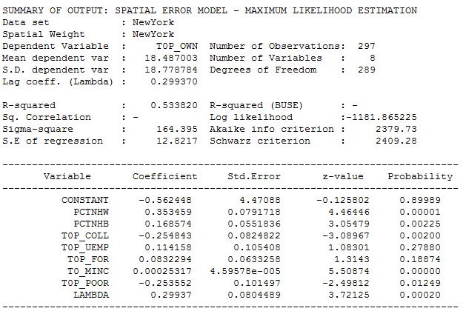
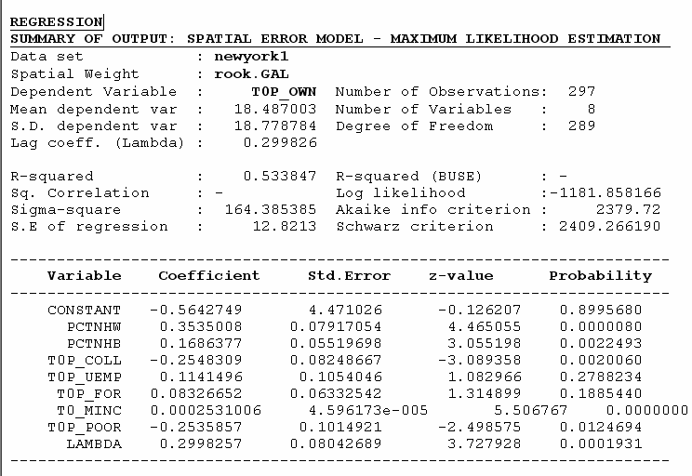
S4 Training Modules
GeoDa: Spatial Regression
We can see that the low probability in the Breusch-Pagan test suggests that there is still
Heteroskedasticity in the model after introducing the spatial lag term. And in the Likelihood Ratio Test of Spatial Lag Dependence, the result is still significant. Therefore, we conclude that although the introduction of spatial lag term improved the model fit, it didn’t make the spatial effects go away.
3) Now let’s review results for the Spatial Error model.
In comparison with the Spatial Lag model output, we also have a designated spatial weight file: rook.GAL. And a coefficient on the spatially correlated errors (LAMBDA) is added as an additional indicator. It has a positive effect and it is highly significant. As a result, the general model fit improved, as indicated in higher values of R-squared and Log likelihood. Like the lag model, the effects of other independent variables remain virtually the same.
NewYork

Slide 12
S4 Training Modules
GeoDa: Spatial Regression
4) Diagnostics of Heteroskedasticity and spatial independence
Similar to the lag model, the Heteroskedasticity test remains significant. Also, the Likelihood Ratio Test of Spatial Error Dependence has a significant result. Therefore, we conclude that although allowing the error terms to be spatially correlated improved the model fit, it didn’t make the spatial effects go away.
5) What should we conclude?
Comparing the spatial lag and spatial error models, we can see both alternative models yield improvement to the original OLS model. Therefore, we should conclude that controlling spatial dependence will improve our model performance. Now the question is which of the two models is better? To some extent, this is an open question. The general advice is first to look for a theoretical basis to inform your choice. If there are strong substantive grounds for one model instead of the other, you should adopt it.
When it is not so clear theoretically, you can compare the model performance parameters: the R-squared and Log likelihood. In our case, the spatial error model has greater R-squared and Log likelihood values. That provides a statistical basis to adopt this solution.
4. Another example
Now, do another exercise with % person below poverty as dependent variable, and % non-Hispanic white, % non-Hispanic black, % college+ educated, unemployment rate, % foreign born, and median household income as independent variables. Run OLS regression, interpret the regression and spatial dependence diagnostics; if spatial dependence exists, try to re-estimate the models with Spatial lag model and Spatial Error model, then compare the output and make your choice.
In this session, we learned to use GeoDa to examine and control spatial dependence in the regression models. By now, you should know the general strategy applied in GeoDa to deal with the spatial dependence issue. You should be able to understand the various diagnostics and regression tests, and able to interpret the results and make decisions accordingly.

